Slide 1

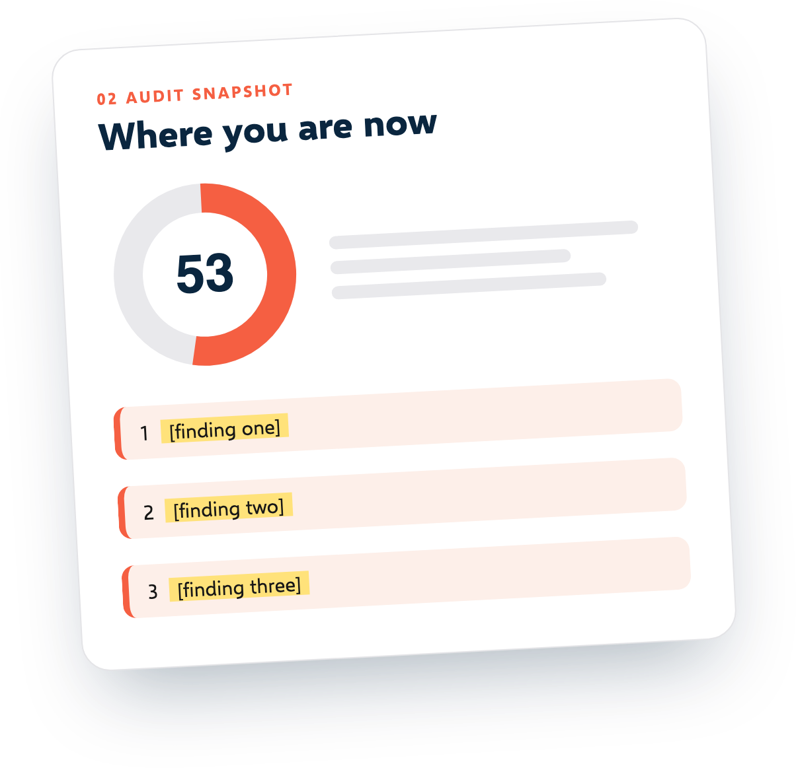

[Your logo]
SEO PROPOSAL
SEO proposal
for [Client name]
Prepared by [your name or agency]
[Date] | Valid until [date]
Free template from SEOSage | seosage.co

Slide 2
[Your logo]
02 / 11
The short version
SECTION 01
THE GOAL
[Client name] wants [the goal in the client's words, such as more enquiries from Google]. Today, [one line from the audit, such as "14 pages are hidden from Google by mistake"]. We propose [what you will do] over [number] months so that [the result the client cares about]. The investment is [price] a month.
[What the client wants]
THE OFFER
[What you will do, and for how long]
THE PRICE
[Price] a month
[Your company] | Proposal for [Client name]
Free template from SEOSage | seosage.co
Notes:
How to fill this in: Write this last. Three sentences: the goal, what you found, what you propose and the price.

Slide 3

[Your logo]
03 / 11
Where you are now: audit snapshot
We crawled [web address] on [date]. This is what we found.
[pages]
[errors]
[warnings]
pages checked
kinds of error
kinds of warning
[score]
TOP THREE FINDINGS
out of 100
1
[Finding one, and why it matters to the business]
2
[Finding two, and why it matters]
3
[Finding three, and why it matters]
The full audit is attached: [file name or link].
[Your company] | Proposal for [Client name]
Free template from SEOSage | seosage.co
Notes:
How to fill this in: Crawl the site first. Pick three findings a business owner will understand. Appendix B turns technical names into plain words.

Slide 4
[Your logo]
04 / 11
Goals and how we will measure them
We agree what success means before we start.
[Goal 1]
[Goal 2]
[Goal 3]
[Measure, such as clicks from Google in Search Console]
[Measure]
[Measure]
TODAY
TODAY
TODAY
[Number]
[Number]
[Number]
TARGET BY MONTH [6]
TARGET BY MONTH [6]
TARGET BY MONTH [6]
[Number]
[Number]
[Number]
[Your company] | Proposal for [Client name]
Free template from SEOSage | seosage.co
Notes:
How to fill this in: Two or three goals, with numbers the client can check. Take the baseline in week one.

Slide 5

[Your logo]
05 / 11
What we will do
The work is in three phases.
MONTH 4 ONWARD
MONTHS 2 TO 3
Grow
MONTH 1
Improve key pages
[New pages, internal links, fixes for new problems]
Fix the basics
[Rewrite titles and copy on the [number] pages that matter most]
[Fix the errors from the audit: broken pages, hidden pages, titles, redirects]
YOU RECEIVE
YOU RECEIVE
YOU RECEIVE
[A fixed-issues list and a new crawl to prove it]
[Updated pages and a before and after report]
[A monthly progress report]
[Your company] | Proposal for [Client name]
Free template from SEOSage | seosage.co
Notes:
How to fill this in: Three phases, so the client sees progress early. Say what they receive in each.

Slide 6
[Your logo]
06 / 11
What we need, and what is not included
+
What we need from you
−
What is not included
[Access to Google Search Console, analytics and the website]. [One person who can approve changes within [3] working days]. [Developer time, if a fix needs one].
[List what is out of scope, such as paid ads, buying links, or writing more than [number] new articles.] No one can promise a ranking. We promise the work and honest reporting.
[Your company] | Proposal for [Client name]
Free template from SEOSage | seosage.co
Notes:
How to fill this in: Name one person who can approve changes, and list the access you need. Be honest here. Clients trust you more for saying that no one can promise a ranking.

Slide 7
[Your logo]
07 / 11
Timeline
[Start date: date]. Expect the first visible changes in [number] weeks, and steady growth over [number] months.
1
2
3
4
Week 1
Weeks 2 to 4
Months 2 to 3
Every month
[Kickoff call and access]
[Phase 1 fixes]
[Phase 2 work]
[Report and call]
[Your company] | Proposal for [Client name]
Free template from SEOSage | seosage.co
Notes:
How to fill this in: A start date and a month-by-month plan. Do not overstate how fast SEO moves.

Slide 8
[Your logo]
08 / 11
Reporting
EVERY MONTH
[Your logo]
Each month you receive [a branded SEO report: the score, what was fixed, what changed and what comes next] and [a 30 minute call]. We crawl the site again every month and compare it with the last crawl.
Monthly SEO report
Fixed
score
New
Worse
NEXT STEPS
1. [First fix]
2. [Second fix]
[Your company] | Proposal for [Client name]
Free template from SEOSage | seosage.co
Notes:
How to fill this in: Say what arrives each month and when.

Slide 9

[Your logo]
09 / 11
Investment
All prices are in [currency]. [Say whether tax is included.]
ONE-OFF AUDIT AND SETUP
MONTHLY SEO RETAINER
[Price]
[Price]
one time
a month
Optional extras
[Price]
Billing: [monthly in advance]. Minimum term: [3 months]. Cancel with [30 days] notice.
[Your company] | Proposal for [Client name]
Free template from SEOSage | seosage.co
Notes:
How to fill this in: Put the price next to the work it covers. State the currency and whether tax is included.

Slide 10

[Your logo]
10 / 11
About us
“
[Two or three lines on who you are, and one result with a real number and a date.]
[Your logo]
[Your company] | Proposal for [Client name]
Free template from SEOSage | seosage.co
Notes:
How to fill this in: Two or three lines, and one real result with a number and a date. No adjectives.

Slide 11

[Your logo]
11 / 11
Next steps
1
2
3
Reply to accept this proposal.
Sign below.
We book the kickoff within [5] working days.
Client | Date
For [your company] | Date
[Your company] | Proposal for [Client name]
Free template from SEOSage | seosage.co
Notes:
How to fill this in: One clear next step is easier to say yes to than a menu.

