Slide 1

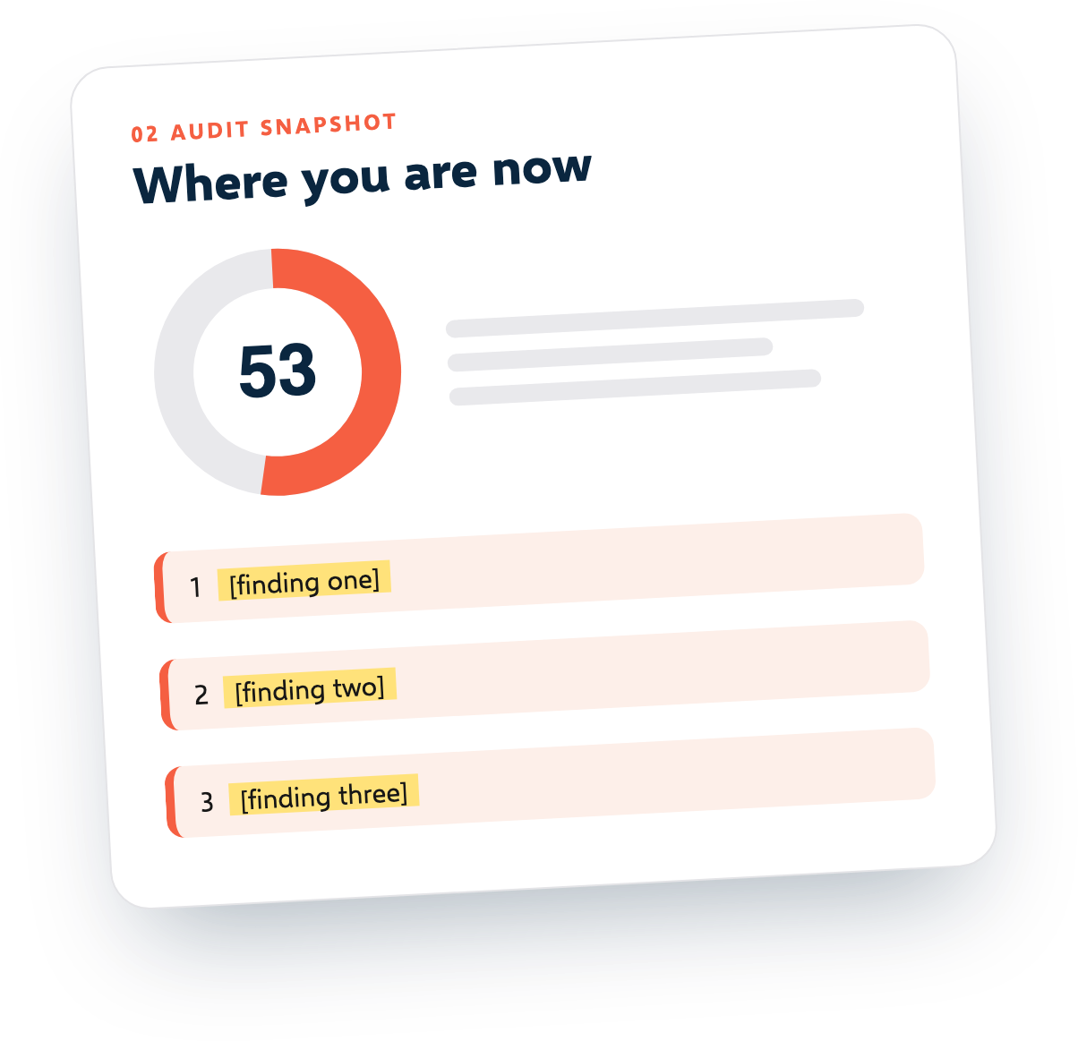
E
Example SEO Studio
SEO PROPOSAL
SEO proposal
for Marketingly (marketingly.org)
Prepared by Example SEO Studio
29 September 2026 | Valid until 29 October 2026
Free template from SEOSage | seosage.co

Slide 2
E
Example SEO Studio
02 / 11
The short version
SECTION 01
THE GOAL
Marketingly wants more enquiries from Google. Today, 14 pages are hidden from Google by mistake and 28 pages have two title tags. We propose three months of fixes and page improvements, followed by monthly growth work, so that more people searching for your services can find you. The investment is $1,200 a month.
More enquiries from Google
THE OFFER
3 months of fixes, then monthly growth
THE PRICE
$1,200 a month
Example SEO Studio | Proposal for Marketingly (marketingly.org)
Free template from SEOSage | seosage.co

Slide 3

E
Example SEO Studio
03 / 11
Where you are now: audit snapshot
We crawled marketingly.org on 29 September 2026. This is what we found.
90
9
15
pages checked
kinds of error
kinds of warning
53
TOP THREE FINDINGS
out of 100
1
14 pages carry a noindex tag, so Google leaves them out.
2
28 pages have two title tags, so Google may show the wrong one.
3
19 pages have no meta description, so Google writes its own.
EXAMPLE: real SEOSage crawl of marketingly.org, 29 Sept 2026. Names, prices and targets are examples.
Example SEO Studio | Proposal for Marketingly (marketingly.org)
Free template from SEOSage | seosage.co

Slide 4
E
Example SEO Studio
04 / 11
Goals and how we will measure them
We agree what success means before we start.
Fewer technical problems
More visits from Google
More enquiries
Health score in SEOSage
Clicks in Search Console
Form sends from Google visits
TODAY
TODAY
TODAY
53
Baseline taken in week 1
Baseline taken in week 1
TARGET BY MONTH 6
TARGET BY MONTH 6
TARGET BY MONTH 6
90 or more
+20% on the baseline
+15% on the baseline
Example SEO Studio | Proposal for Marketingly (marketingly.org)
Free template from SEOSage | seosage.co

Slide 5

E
Example SEO Studio
05 / 11
What we will do
The work is in three phases.
MONTH 4 ONWARD
MONTHS 2 TO 3
Grow
MONTH 1
Improve key pages
New pages, internal links, fixes for new problems
Fix the basics
Rewrite titles and descriptions and improve the text on the 10 pages that matter most
Fix the errors from the audit: hidden pages, double titles, broken pages, redirects
YOU RECEIVE
YOU RECEIVE
YOU RECEIVE
A fixed-issues list and a new crawl to prove it
Updated pages and a before and after report
A monthly progress report
Example SEO Studio | Proposal for Marketingly (marketingly.org)
Free template from SEOSage | seosage.co

Slide 6
E
Example SEO Studio
06 / 11
What we need, and what is not included
+
What we need from you
−
What is not included
Access to Google Search Console, analytics and the website. One person who can approve changes within 3 working days. Developer time if a fix needs one.
Paid ads, buying links, and writing more than 2 new articles a month. No one can promise a ranking. We promise the work and honest reporting.
Example SEO Studio | Proposal for Marketingly (marketingly.org)
Free template from SEOSage | seosage.co

Slide 7
E
Example SEO Studio
07 / 11
Timeline
We start on 5 October 2026. Expect the first visible changes in 4 weeks, and steady growth over 6 months.
1
2
3
4
Week 1
Weeks 2 to 4
Months 2 to 3
Every month
Kickoff call and access
Phase 1 fixes
Phase 2 work
Report and call
Example SEO Studio | Proposal for Marketingly (marketingly.org)
Free template from SEOSage | seosage.co

Slide 8
E
Example SEO Studio
08 / 11
Reporting
EVERY MONTH
Example SEO Studio
Each month you receive a branded SEO report (the score, what was fixed, what changed and what comes next) and a 30 minute call. We crawl the site again every month and compare it with the last crawl.
Monthly SEO report
Fixed
score
New
Worse
NEXT STEPS
1. [First fix]
2. [Second fix]
Example SEO Studio | Proposal for Marketingly (marketingly.org)
Free template from SEOSage | seosage.co

Slide 9

E
Example SEO Studio
09 / 11
Investment
All prices are in US dollars, excluding tax. These are example prices.
ONE-OFF AUDIT AND SETUP
MONTHLY SEO RETAINER
$1,500
$1,200
one time
a month
Optional extras
Quoted on request
Billing: monthly in advance. Minimum term: 3 months. Cancel with 30 days notice.
Example SEO Studio | Proposal for Marketingly (marketingly.org)
Free template from SEOSage | seosage.co

Slide 10
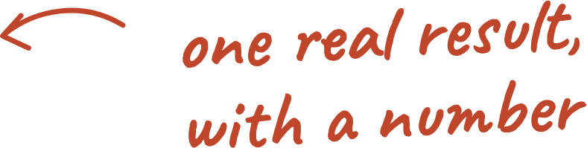
E
Example SEO Studio
10 / 11
About us
“
Example SEO Studio helps small businesses get found on Google. (Replace this with two or three lines about you and one result with a real number and a date.)
Example SEO Studio
Example SEO Studio | Proposal for Marketingly (marketingly.org)
Free template from SEOSage | seosage.co

Slide 11

E
Example SEO Studio
11 / 11
Next steps
1
2
3
Reply to accept this proposal.
Sign below.
We book the kickoff within 5 working days.
Client | Date
For Example SEO Studio | Date
Example SEO Studio | Proposal for Marketingly (marketingly.org)
Free template from SEOSage | seosage.co

